Slide 1
Efficient Vision and Language Models for Autonomous Systems
Sandesh Bharadwaj
Master’s Thesis Defense - April 16, 2024
Computer Science
sandeshb@bu.edu

Slide 2
Table of Contents
Introduction
Related Work
Task Offloading through Reinforcement Learning
Passing the Driving Test
Conclusion

Slide 3
Introduction

Slide 4

Introduction
Vision-based models face constraints in edge deployment
Limited data availability
Computational Costs
Energy limitations
Diminishing returns in accuracy as
model size

Slide 5
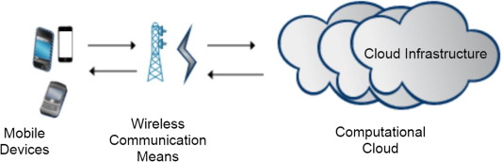
Introduction
Existing approach: Offload all processing to cloud, use powerful models.
Accurate inference
Transmission and processing overhead
Energy costs
Unsuitable for dynamic, real-world agents
Autonomous Driving
Crowd Navigation
Emergency Response Coordination

Slide 6
Introduction
Minimize Energy Consumption to build efficient autonomous systems.
How to achieve robust vision-based systems optimized for safety and efficiency in dynamic environments?

Slide 7
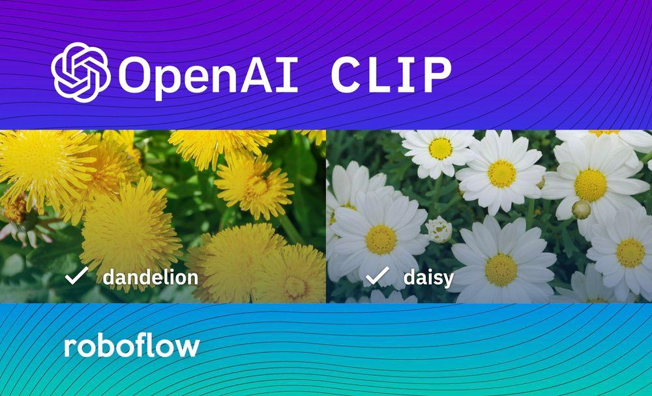



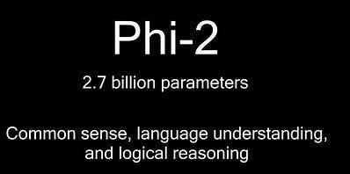
Introduction
LLMs (and VLMs) are all the rage everywhere!
Conversation + perception + action
Examples in Autonomous Driving:
DriveGPT4 - Uses GPT4 to calculate control signals (vehicle speed, turning angle)
DriveMLM - Uses CLIP + LLaMA as encoder/decoder for determining control

Slide 8
Introduction
Upside:
Generalizable
Adapt well to out-of-domain data easily
Fine-tuning
Prompt-engineering
Retrieval-Augmented Generation (RAG)
Can integrate well into other systems
Downsides:
Tendency to hallucinate
Demonstrate bias
Resource intensive

Slide 9
Introduction
For integration with autonomous driving:
Safety
Accuracy
Minimal energy consumption
How to assess the efficacy of LMs for autonomous driving?

Slide 10
Introduction
Research Contributions:
1. How to achieve robust vision-based systems optimized for safety and efficiency in dynamic environments?
Evaluation of vision-based models for deployment on edge and cloud within CARLA
‘Routing’ policy that offloads inference to local or cloud devices based on situation.
New CARLA Metric: Ecological Navigation Score (ENS)
Accounts for consequences of route deviations and energy consumption on driving agent effectiveness.

Slide 11
Introduction
Research Contributions:
2. How to assess the efficacy of LMs for autonomous driving?
Novel dataset to evaluate performance of LLMs and VLMs for autonomous driving.
Questions commonly found on learner’s license examinations.
Driving manuals from all 50 states and districts in the US.
Straightforward truth-false assertions to complex reasoning-based queries.
Evaluations of tiny (small-scale) LLMs on this dataset
LMs must achieve minimum score of 80% to pass

Slide 12
Related Work

Slide 13
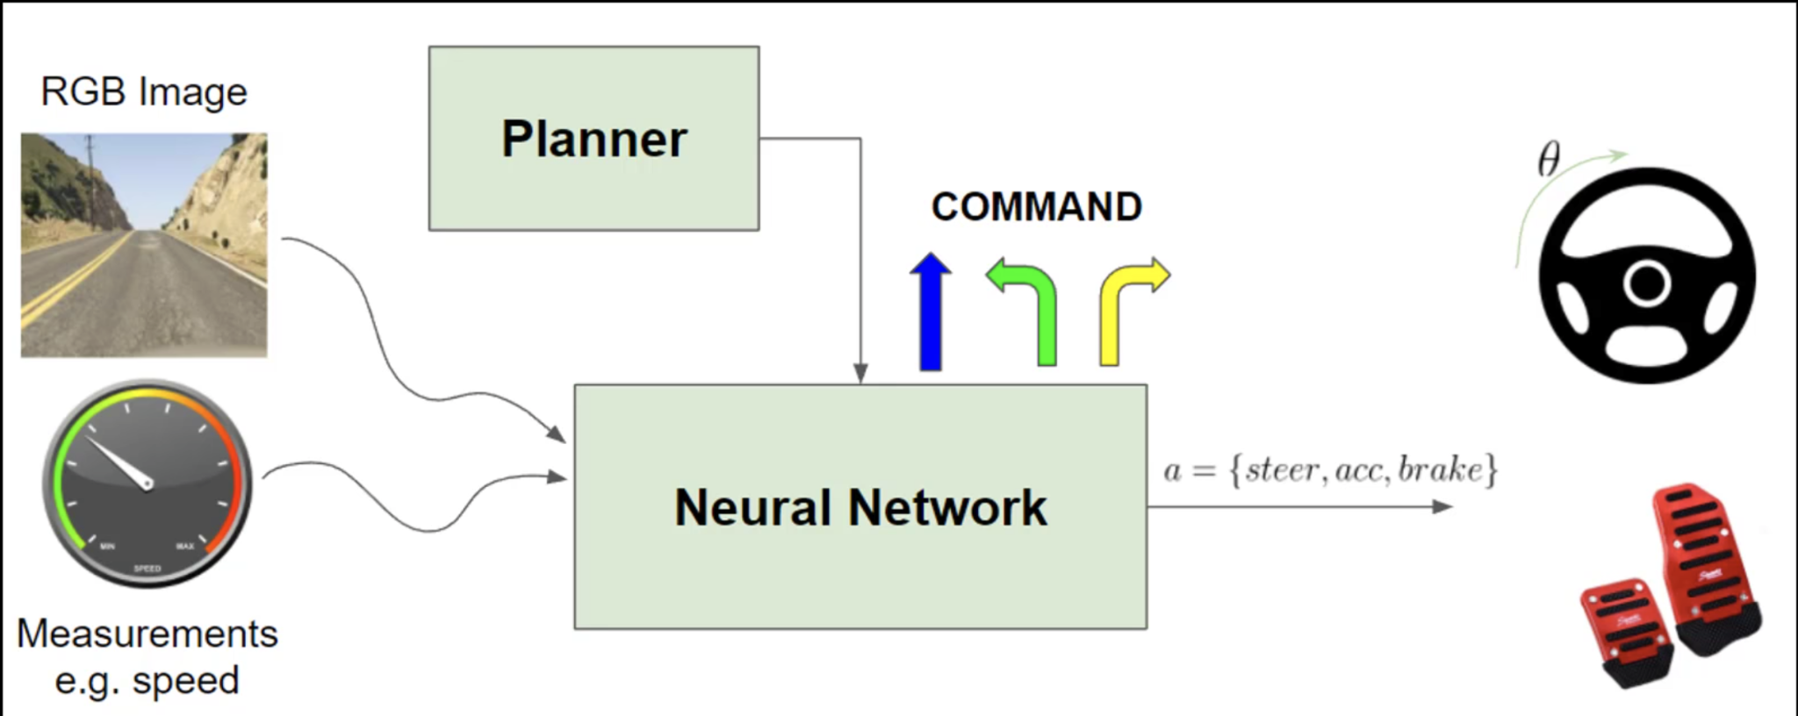
Imitation Learning
Given: Expert / Experts
Goal: train a policy to mimic expert actions
How?
Figure out the best mapping between state (feature) and action (labels).
Imitation learning usually done through behavior cloning
Taken from “End-to-end Driving via Conditional Imitation Learning”

Slide 14
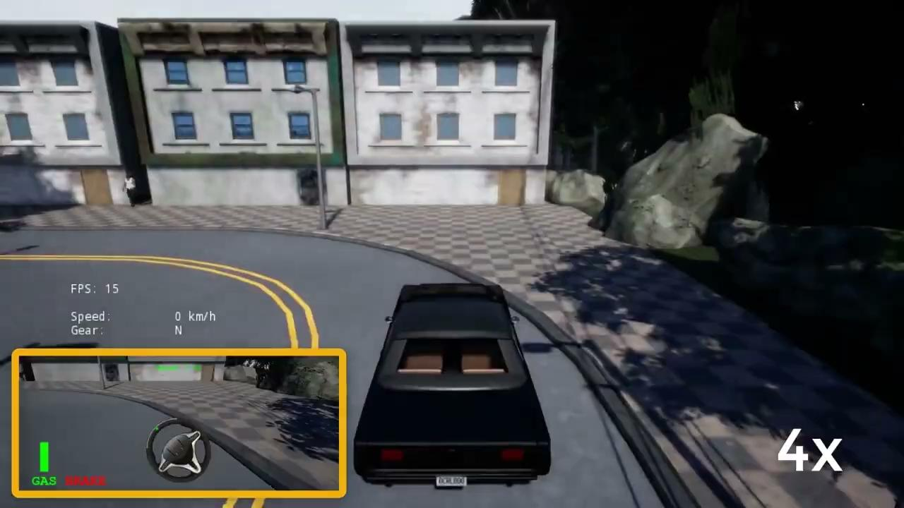
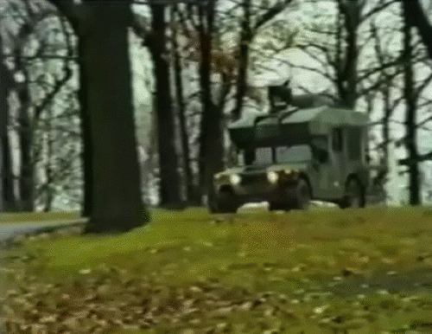
Imitation Learning
End-to-end Driving via Conditional Imitation Learning
ALVINN: The first autonomous land vehicle

Slide 15
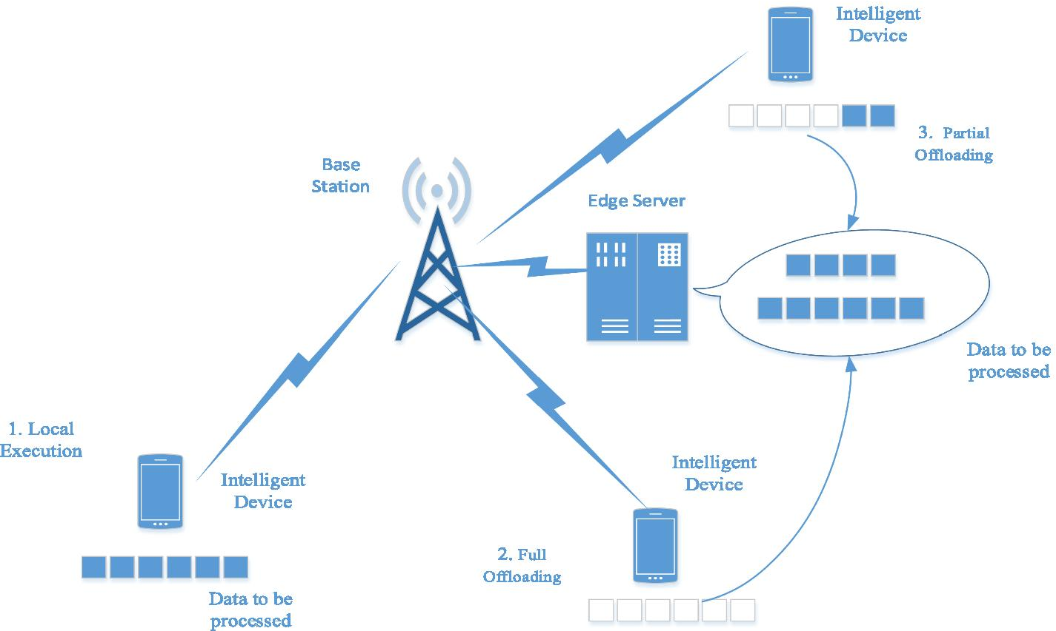
Task Offloading
Task Offloading
Leverage cloud capacity for advanced hardware and large models
Leverage edge devices for real-time computing
Offload based on requirement.
Existing research:
Hybrid approaches for efficient query selection.
Does not account for computational delay.
Not suitable for real-time dynamic environments.
Taken from “A new task offloading algorithm in edge computing”

Slide 16
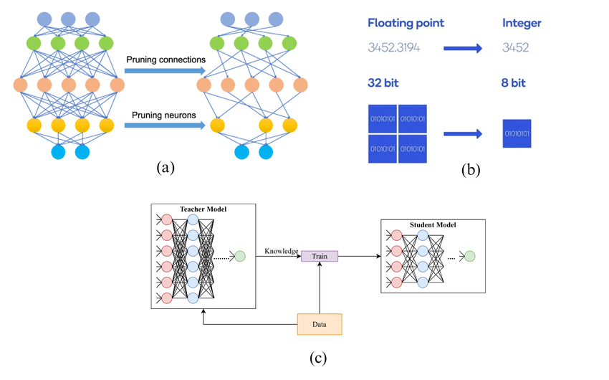
Energy-Efficient Models
Energy-efficient models
Optimize computational efficiency, resource utilization.
Reduce carbon emissions.
How to use efficient models?
Model Pruning:
Remove unnecessary parameters from trained models.
Model Quantization:
Allows use of large models with lower-precision weights.
Disadvantages:
Loss of model performance
Task-specific optimization required.
Model Pruning Model Quantization

Slide 17
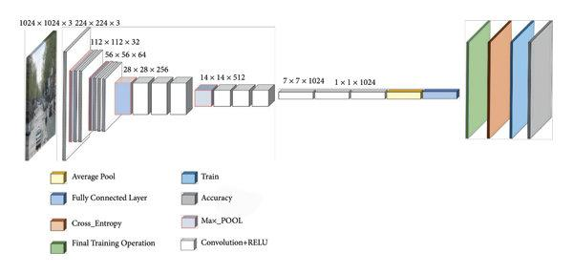
Energy-Efficient Models
Efficient Architectures:
Low-power.
Low-complexity.
Balance between efficiency and accuracy.
Optimized for edge devices.
EfficientNet, MobileNet.
MobileNetV1

Slide 18
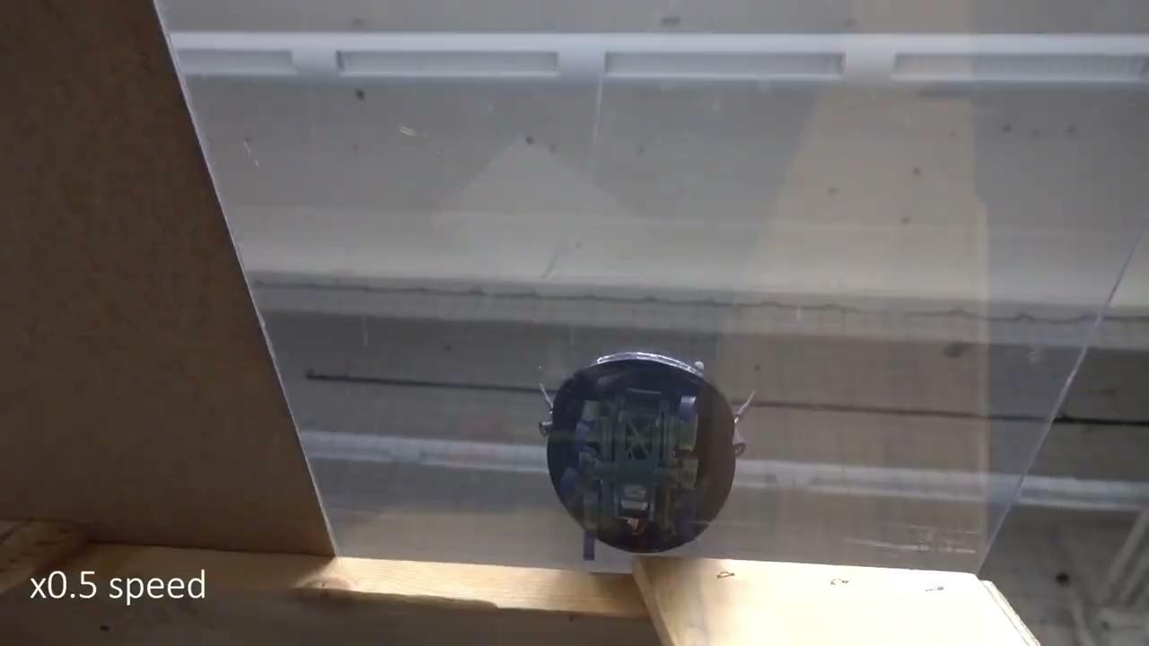
Decision-making in Dynamic Environments
Reinforcement Learning applied to optimize decision-making
Efficient navigation
Obstacle Avoidance
Path planning
Disadvantages:
Sim2Real gap
Lack of real-world data
Computational constraints
Taken from “Learning to Adapt”

Slide 19
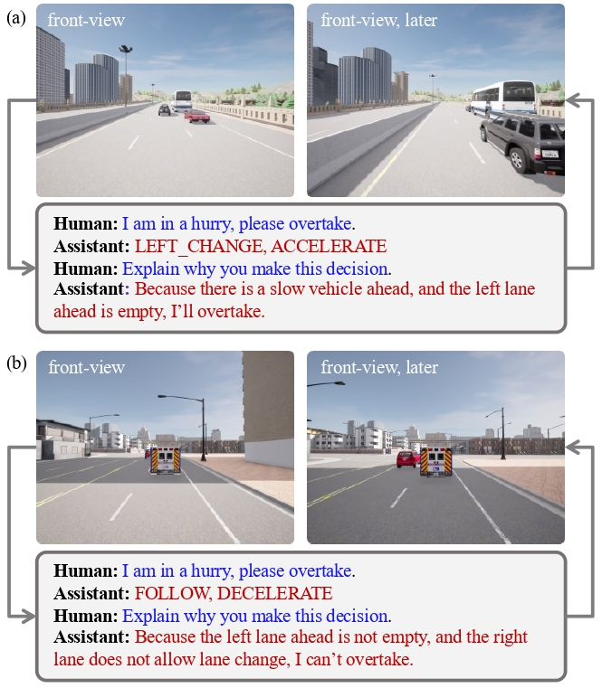
Language Models
LMs
Contextual understanding
In-context learning capabilities
Common sense knowledge
Larger LMs (>7B) tend to perform better
Large domain gap
Tiny LMs (<7B)
Emergent abilities at small scale
Computational efficiency
Deployable on edge
Taken from “DriveMLM”

Slide 20
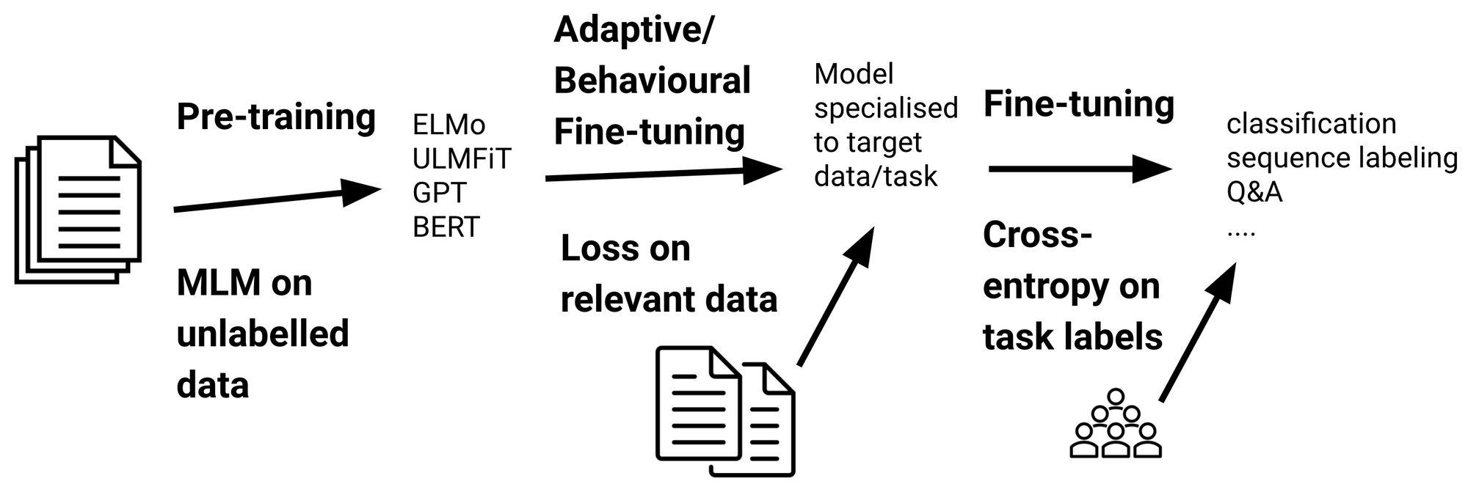
Language Models
Finetuning:
Adapting the pre-trained model to specific tasks (partial retraining)
Update parameters of certain layers
Small labelled dataset required for fine-tuning.
Potential for domain mismatch and overfitting.
Dependency on quality and relevance of pre-training.

Slide 21
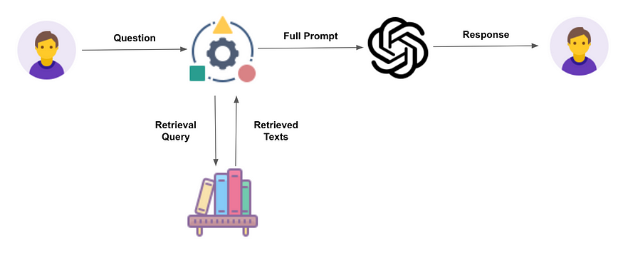
Language Models
Retrieval-Augmented Generation:
Hybrid approach.
Provide contextual information to generative model.
Factual accuracy and contextual relevance.
Risk of noise in retrieval
Computational overhead
Design complexity

Slide 22
Task Offloading through Reinforcement Learning

Slide 23
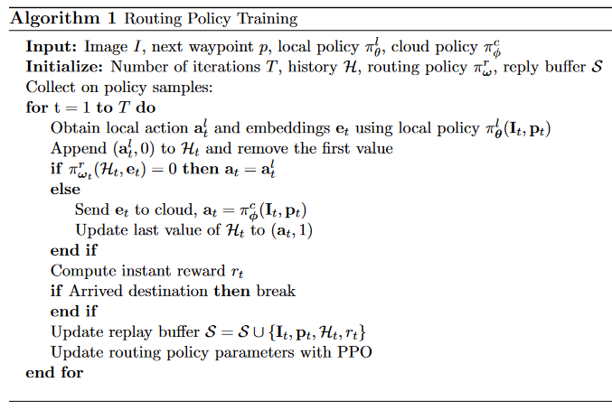
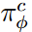
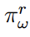
Task Offloading through Reinforcement Learning
Objective: learn a ‘routing’ policy that can determine dynamic allocation of local and cloud resources.
Optimize energy efficiency and real-time performance.
3 policies:
Local driving policy
Cloud driving policy
Routing policy

Slide 24
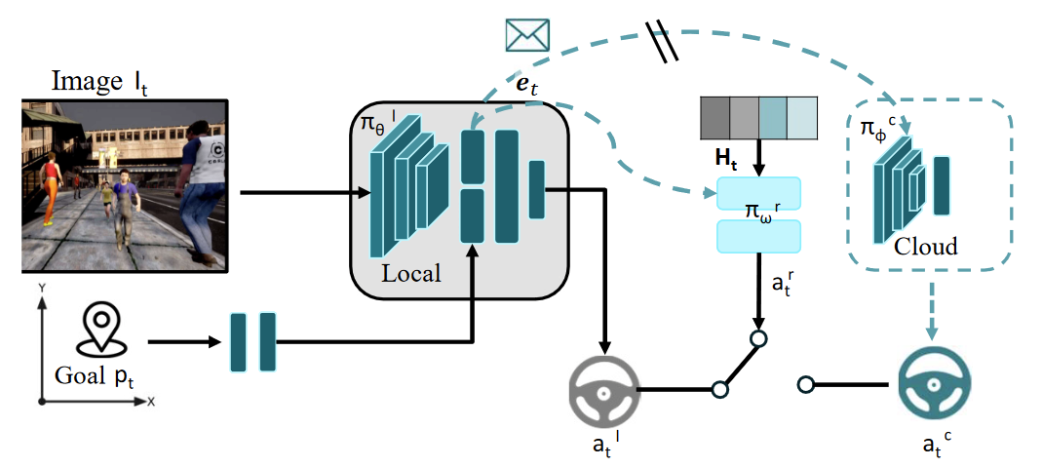
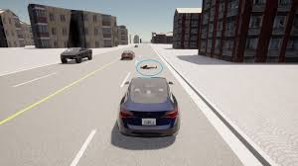
Problem Formulation

Slide 25
Learning Driving Policies for Local and Cloud Settings
General architecture:
Visual semantic feature extractor
MLP to extract goal features
Goal-conditional module to concatenate image features and goal features and predict agent actions
Local and Cloud policy share common semantic feature extractor.

Slide 26
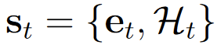
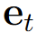
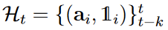
Learning Routing Policy
State space
- image embeddings + goal features
a_{i} - previous actions
1_{i} - indicator function
Action space: 0/1
Reward function:
Geodesic reward r_{geo}
Speed reward r_{speed}
Energy disadvantage r_{energy}
Collision penalty collision

Slide 27
Experiments
Driving data collected from our custom CARLA environment.
30 vehicles spawned around ego vehicle’s route
Heuristic policy for data collection
Multiple routes across CARLA Town 10 with waypoints
Driving agent follows waypoint from start to destination.
Stops for other vehicles blocking its path, allows them to pass, proceeds along route if clear.
Routing policy:
Policy network consists of two hidden layers, each having 16 units.
Value network consists of two hidden layers with 256 units each.
Training protocol
AdamW optimizer, 200 epochs.
Routing policy trained for 1000 episodes of 1500 steps max.

Slide 28
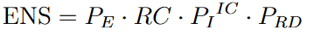
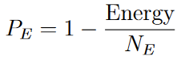
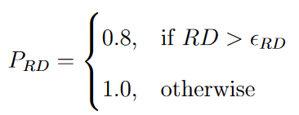
Evaluation Metrics
Ecological Navigation Score
Balance between driving performance and ecological considerations.
P_{E} - energy consumption penalty
P_{I} - infraction penalty = 0.5
IC - number of infractions normalized per kilometre
P_{RD} - route deviation penalty
ϵ_{RD} - route deviation threshold = 30m
RC - route completion (%)
Run-Time - FPS

Slide 29
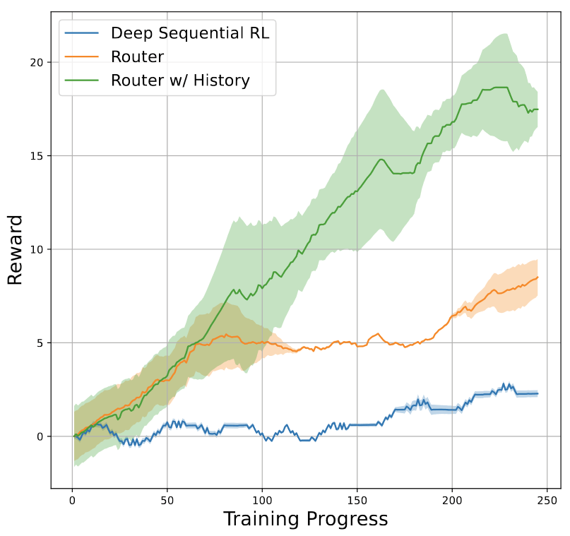
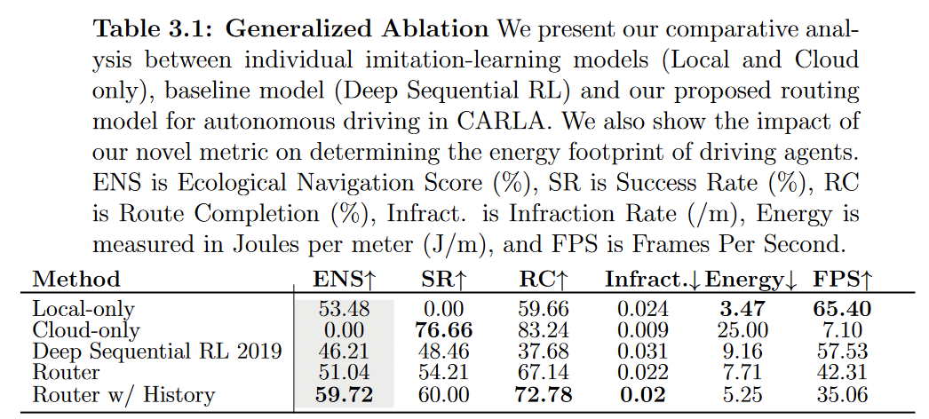
Results
Cloud-only model has 0 ENS score, due to usage of cloud, which is ecologically inappropriate.
Routing models perform well
High ENS score and RC score.
Potential for efficient inference through RL-based switch
Routing models also see significant reward progression through training.
Local models must be improved in order to improve the performance of routers as well.

Slide 30
Language Models

Slide 31
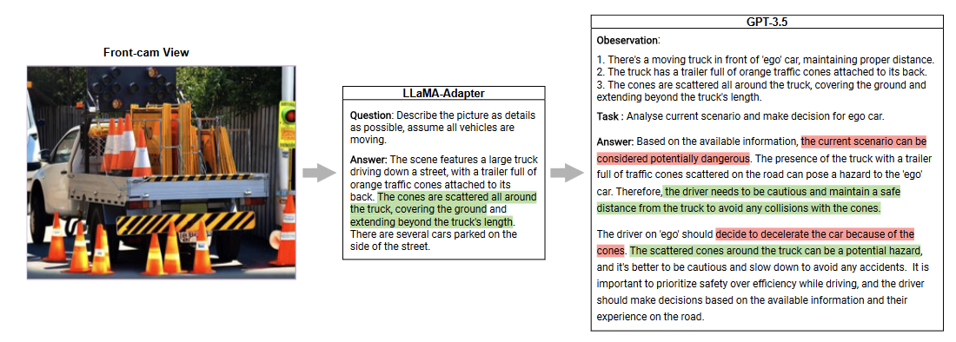
LLMs and Autonomous Driving
Current research incorporates language into autonomous driving pipelines
Do not showcase LM level of understanding about common driving rules known and followed by humans
Important to understand potential for hallucination and bias in LMs before integration.
How to do this?
Taken from “Drive like a Human”

Slide 32
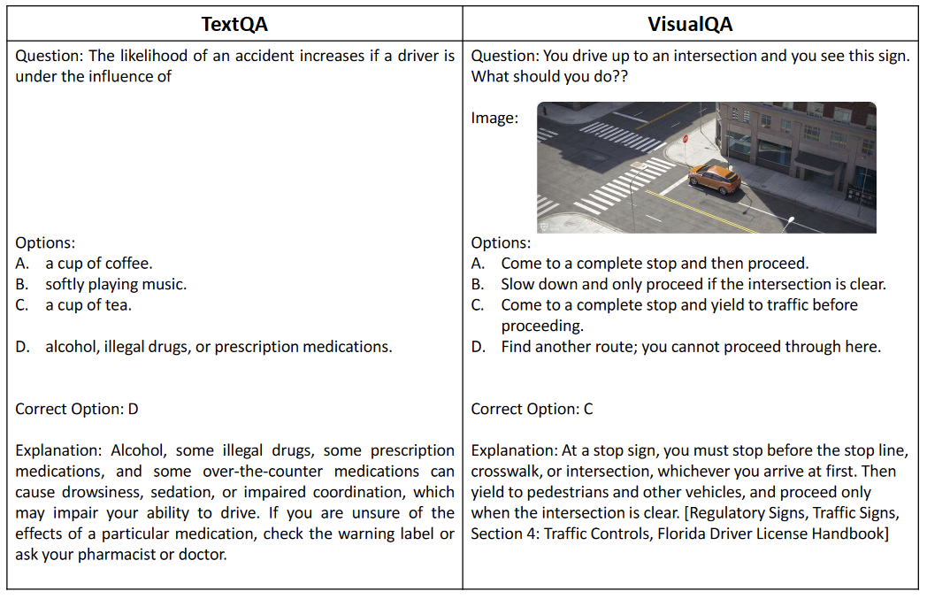
Dataset
New Dataset for driving benchmark
38,452 single-correct QA pairs
TextQA - text-based question-answer pairs
VisualQA - image-question-answer triplets. High resolution images (1080p)
11:9 split between TextQA and VisualQA

Slide 33
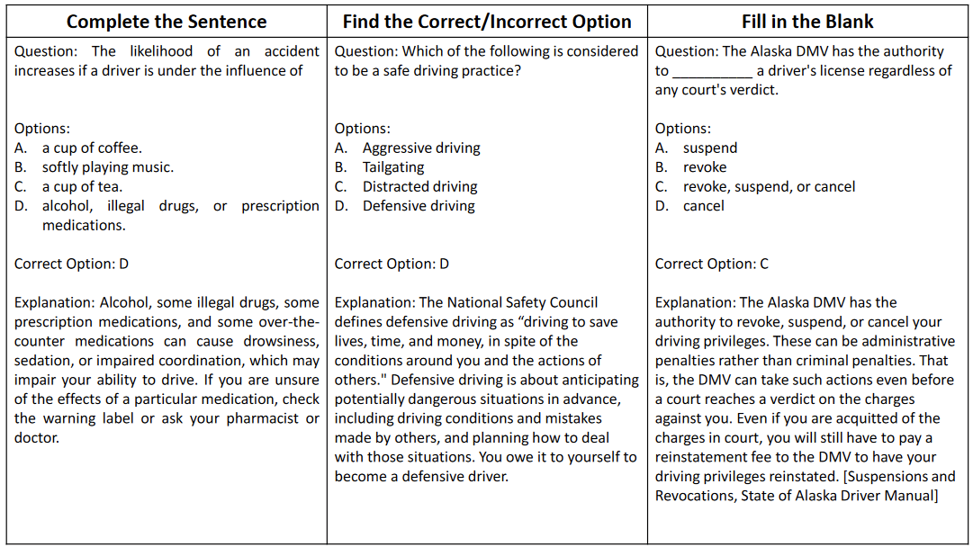
Dataset
TextQA categorization by question type
True-False
Multiple-Choice
Categorization by style:
Complete the Sentence
Find the Correct/Incorrect Option.
Fill in the Blank.

Slide 34
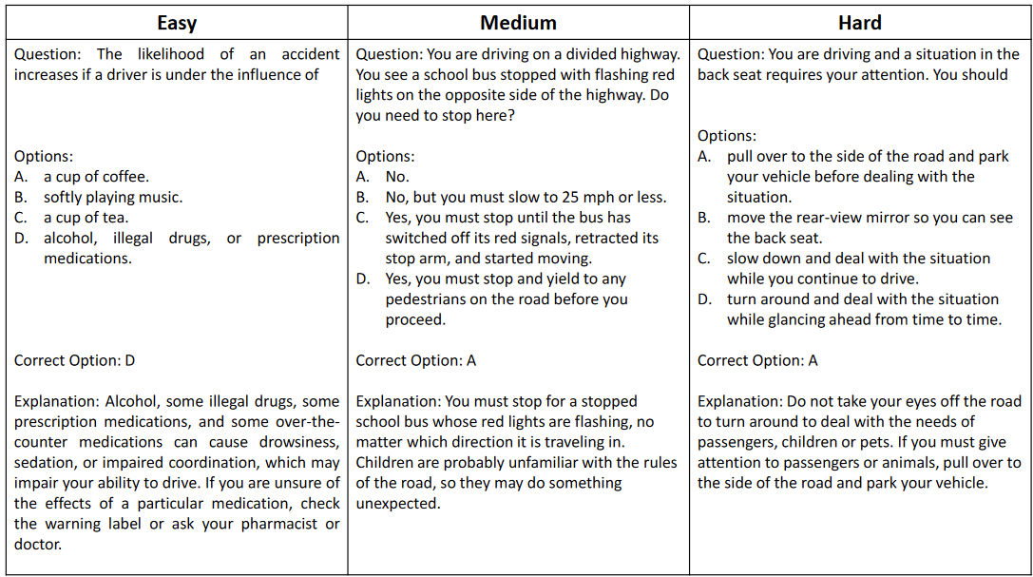
Dataset
Categorization by level of difficulty
Easy
Medium
Hard

Slide 35

Dataset
Driving Manuals of all 50 states and federal districts in the United States
PDF
Text
Test sets for TextQA and VisualQA, consisting of 200 questions each, sampled across all difficulty levels.
Minimum score of 80% required to pass test. (human-level understanding)

Slide 36


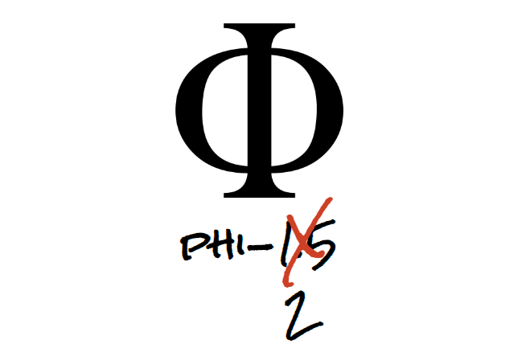
Passing the Driving Test - Choose your LLMs
We only select Tiny LLMs (<=7B params).
Prefer choosing chat versions over base models, better suited for prompting.
For all experiments
TinyLlama (1.1B params)
Gemma 2B (2B params)
Phi 2 (2.7B)
Baselines include previous models and two additional models:
Gemma 7B (7B params)
Phi 1.5B (1.3B params)

Slide 37
Passing the Driving Test - Experiments
3 sets of experiments, 2 subsets for each
Subsets are experiments w/ and w/o Chain-Of-Thought Reasoning
Baseline evaluations
Fine-tuning on TextQA
Use of Context (RAG)
Training Protocol:
TextQA subset - 17,456 questions.
Each LLM follows prompt template used during pre-training.
Additional conditions added for providing correct answer options, explanation (step-by-step reasoning) for strict adherence to requirements.
Finetuning for 3 epochs using QLoRA.

Slide 38
Passing the Driving Test - Evaluation Metrics
BLEU - BiLingual Evaluation Understudy
Traditionally used for evaluating quality of machine translations.
Calculate precision of n-grams in prediction compared to references.
Has high correlation with human judgement of prediction quality
Good BLEU score: >0.08
ROUGE - Recall-Oriented Understudy of Gisting Evaluations
N-gram based set of metrics used for evaluating quality of generated summaries.
Focuses on comparing content overlap and similarity, capturing effectiveness of summarization systems for generating relevant summaries. (case-insensitive)
Objective measure of answer quality, but does not capture factual correctness and relevance.
Good scoring:
ROUGE-1: 0.4 - 0.5
ROUGE-2: 0.2 - 0.4
ROUGE-L and ROUGE-L-SUM: 0.25-0.4
Phrase Match
Matches generated text to reference texts, similar to exact match.
Phrase extraction and alignment ensures matching between predictions and references.
Precision is computed over number of aligned phrases.
Objective assessment of answer relevance and factual correctness.
Absolute score: >0.8 is good

Slide 39
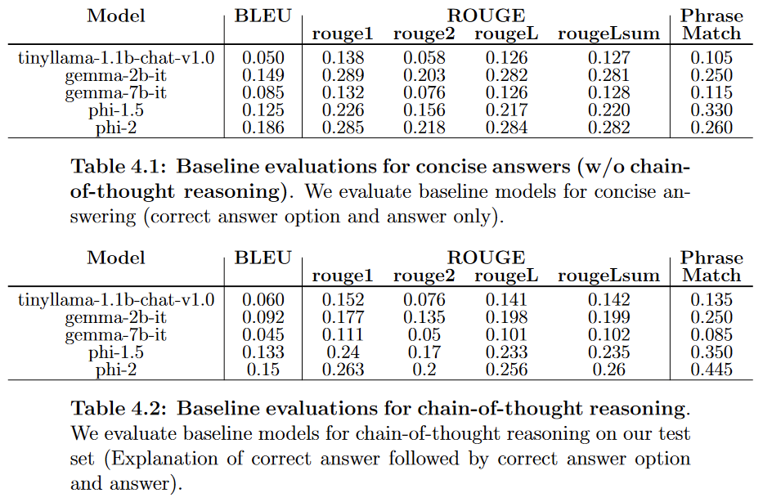
Passing the Driving Test - Baseline Evaluations
Baseline evaluations for concise answering
Low phrase matching scores
Baseline evaluations for chain-of-thought reasoning
Significantly higher scores across models
Gemma models dont seem to perform well in explaining reasoning.

Slide 40
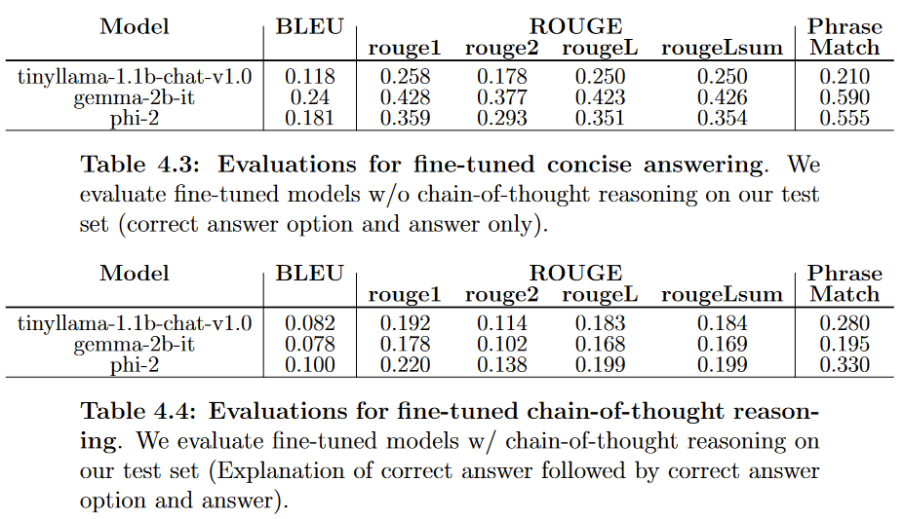
Passing the Driving Test - Fine-Tuned Evaluations
Fine-tuning for concise answering improves scores across all models
ROUGE and BLEU scores improve for all models.
Fine-tuning with chain-of-thought reasoning decreases model performance
This is likely due to the need to improved training protocols (more epochs, better hyperparameter tuning)
TinyLlama performs better, reporting a phrase match score of 0.280

Slide 41
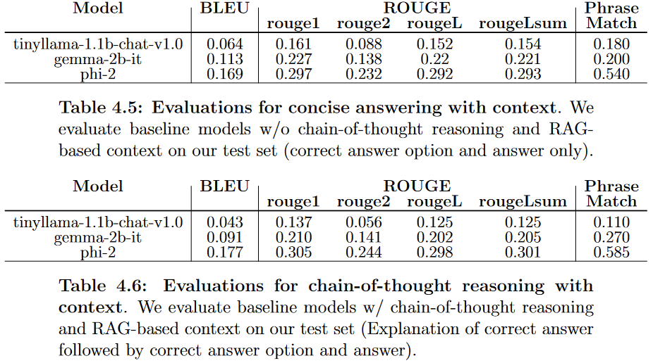
Passing the Driving Test - Use of context - Baseline Evaluations
Baseline models improve significantly with the use of context
Adding chain-of-thought reasoning generally improves baseline performance
TinyLlama performs worse.

Slide 42
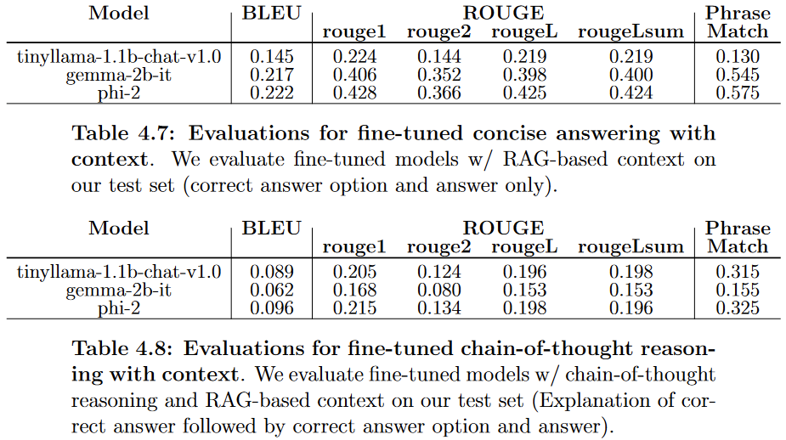
Passing the Driving Test - Use of context - Fine-Tuned Evaluations
Fine-tuned models improve significantly with the use of context
TinyLlama does not perform well with context for concise answering.
Finetuning with chain-of-thought reasoning needs more experimentation and optimization of training protocol
TinyLlama is the only model that performs better in chain-of-thought finetuning

Slide 43
Conclusion

Slide 44
Conclusion
Is RL-based offloading feasible?
Can we incorporate energy considerations for evaluating feasibility of autonomous driving agents?
Yes. ENS metric shows that efficient offloading can be performed without compromising on performance
Improvements in the reward function and local and cloud driving agents will also improve performance across all metrics.
Is passing the driving test a good test of an LLM’s capabilities?
Can our LLM student pass the learner’s test?
Possibly. Most models show improvements with fine-tuning and chain-of-thought reasoning, as expected.
Fix training protocol for chain-of-thought reasoning
Chain-of-thought reasoning works for TinyLLama
Important for large models - Gemma 2, Phi 2
Evaluating LLMs on QA datasets tailored for driving tasks can be a good measure of their capability to understand driving concepts
Tiny LLMs have potential for deployment in autonomous real-time systems.

Slide 45
Thanks! Open to questions!

